Slide 1

Intelligent Financial Planning System
Personal Finance Tracker
Presented by:
Balachandar S
Anshul Chauhan
Notes:
Line spacing + Page numbers

Slide 2

Project Overview
Introduction:
The Personal Finance Tracker application is a user-friendly system that helps individuals manage their finances efficiently.
Purpose:
Track expenses effectively.
Analyze financial habits with visual insights.
Set and monitor budgets to achieve financial goals.
Objective:
To provide a comprehensive platform for users to manage their personal finances, track expenses, and make informed decisions.
Outcome:
A functional web-based system that delivers personalized insights into spending patterns and supports financial planning.

Slide 3


Key Features
User Authentication:
Secure user registration and login/logout.
Dashboard access post-login.
Expense Management:
Add, update, delete, and view expenses.
Financial Reporting:
Generate reports with summaries and visualizations.
Export reports to PDF.
Dashboard & Data Visualization:
Interactive charts and spending trends analysis.
Budget Planning and Alerts:
Set budgets for categories.
Alerts for overspending.

Slide 4

Technologies Used
Backend:
Django: Python-based web framework for secure and scalable application development.
Frontend:
HTML, CSS, and Bootstrap: For designing a responsive and intuitive user interface.
Database:
SQLITE/MySQL: For managing expense data.
Visualization:
plotly: For generating charts and graphs to visualize financial insights.
Testing:
Django's Testing Framework: For validating functionalities in each module.

Slide 5
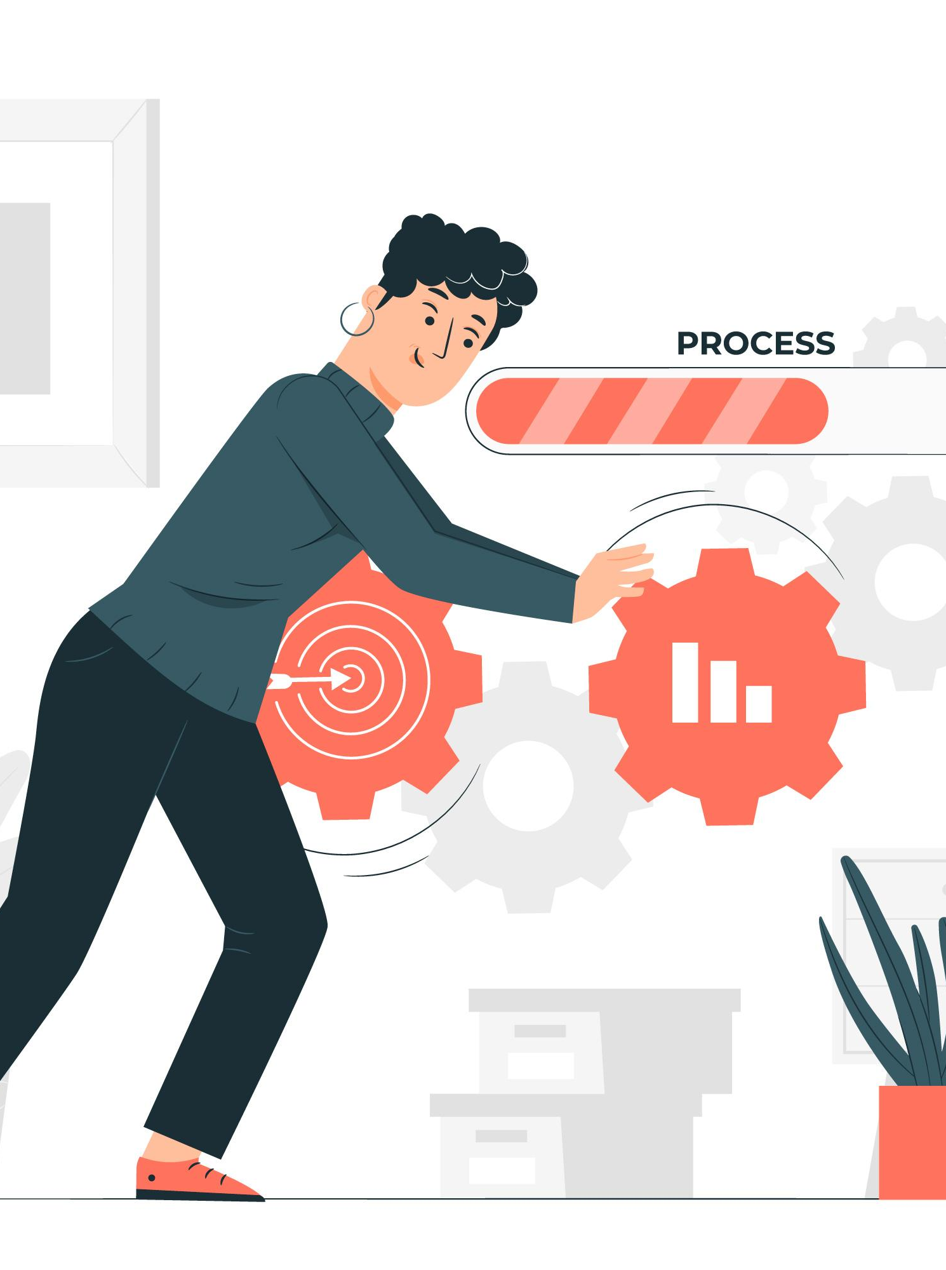
Development Process
Milestone 1 :
User Authentication:
Developed registration, login, and logout functionalities.
Implemented secure session management and validation.
Expense Management:
Designed the database for expense tracking.
Created interfaces to add, update, view, and delete expenses.
Milestone 2 :
Financial Reporting:
Built the report generation feature with date range selection.
Implemented visualizations (charts and graphs) and PDF export.

Slide 6
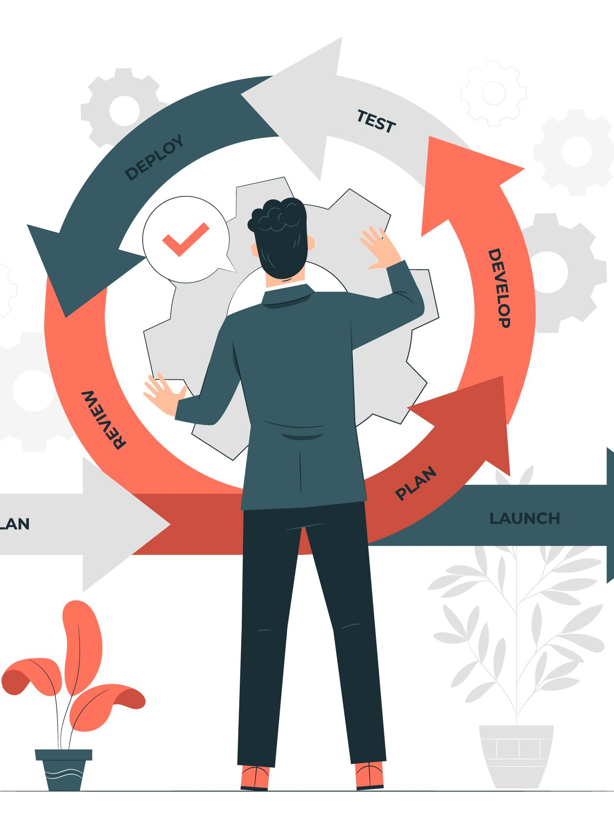
Development Process
Milestone 3 :
Dashboard & Data Visualization:
Developed an interactive dashboard displaying financial metrics.
Added filters for expense categories and date ranges.
Designed real-time updates for the dashboard.
Milestone 4 :
Budget Planning & Alerts:
Created functionality to set budget limits.
Implemented alerts for overspending and budget tracking.
Added a comparison of actual spending vs. budgets.

Slide 7


Challenges & Solutions
Integration of Visualization Tools: Creating dynamic, interactive charts for spending trends.
Responsive Design: Ensuring the dashboard and features worked seamlessly across devices.
Secure User Authentication: Implementing robust session management and input validations.
Budget Alerts: Accurately calculating and notifying users about budget limits.
Plotly: Plotly is used to create interactive visualizations to help explore data and gain insights. It offers a variety of chart types
Bootstrap: Adopted Bootstrap to ensure responsive and user-friendly design.
Framework: Utilized Django’s built-in authentication mechanisms for secure user management.
XHTML: XHTML is a markup language that combines the flexibility of HTML (Hypertext Markup Language) with the strict syntax and extensibility of XML (Extensible Markup Language).

Slide 8
Class Diagram
User Class
Attributes:
username
Password
Methods:
register()
login()
logout()
Expense Class
Attributes:
amount
category
date
description
Methods:
add_expense()
update_expense()
delete_expense()
Attributes:
date_range
total_expenses
average_expenses
Methods:
generate_report()
export_to_pdf()
Budget Class
Attributes:
category
limit
current_spending
Methods:
set_budget()
check_budget()
notify_alert()
Report Class
Salary
Monthly Budget

Slide 9

Implementation Steps
Requirements Gathering:
Identified user needs, including:
Expense tracking.
Budget planning with alerts.
Generating and visualizing financial reports.
Design Phase:
Created:
System architecture.
Class diagrams (User, Expense, Report, Budget).
Database schema for managing user and expense data.
Development Milestones:
Milestone 1:
User authentication: Secure login, registration, and logout features.
Expense management: Add, update, delete, and view expense entries.
Milestone 2:
Financial reporting: Implemented summaries, visualizations, and PDF export.
Milestone 3:
Dashboard: Interactive metrics and filters for category and date.
Milestone 4:
Budget planning and alerts: Set limits, receive notifications, and compare spending.
Testing and Validation:
Used Django’s testing framework to ensure functionality.
Form validations and error handling for all modules.
Deployment:
Deployed the application on [hosting platform, e.g., AWS, Heroku, or local server].
Ensured accessibility and responsiveness on multiple devices.

Slide 10

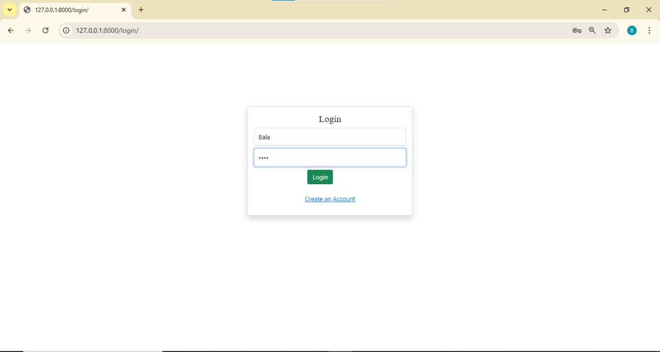
Screenshots
Login Page
A secure and straightforward login interface with form validation.

Slide 11

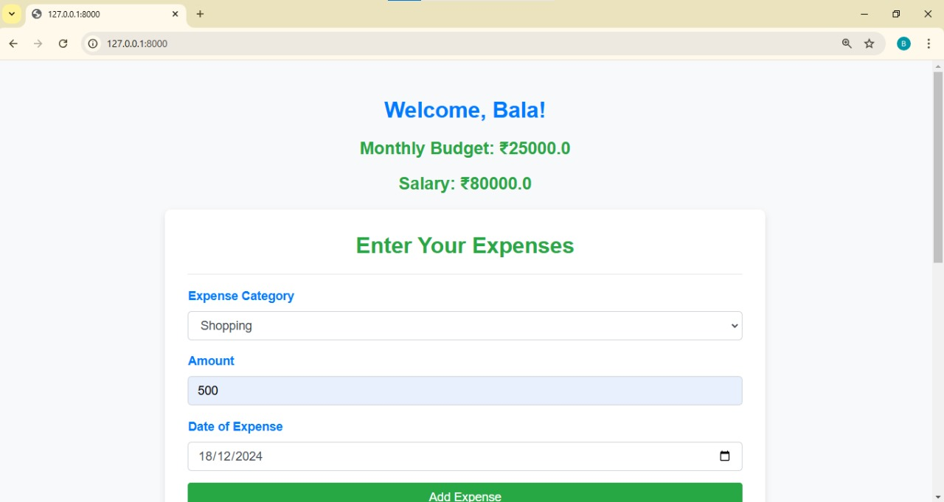
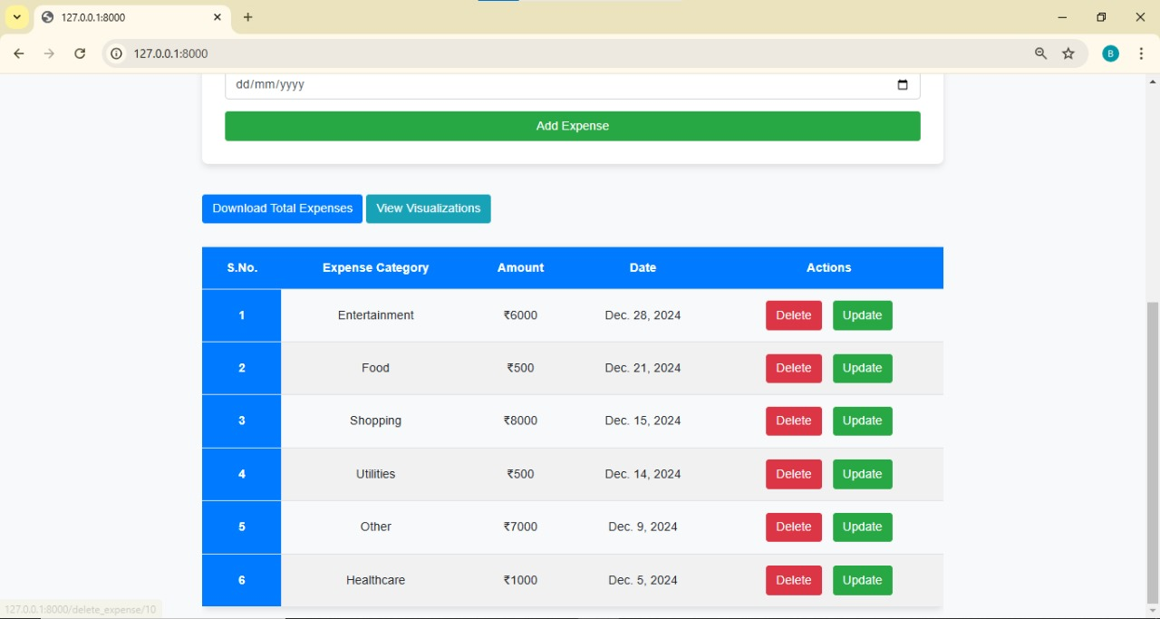
Screenshots
Enter Your Expense Page
User-friendly form for adding daily expenses, categorized for better management

Slide 12

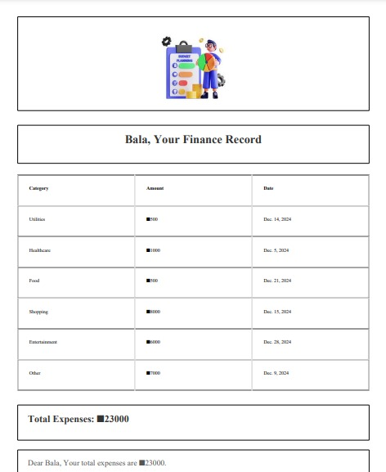
Screenshots
Finance Record
Displays a detailed list of all expenses, sorted by date, category, and amount.

Slide 13
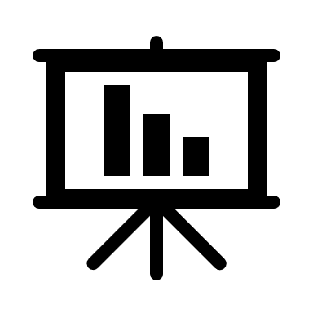
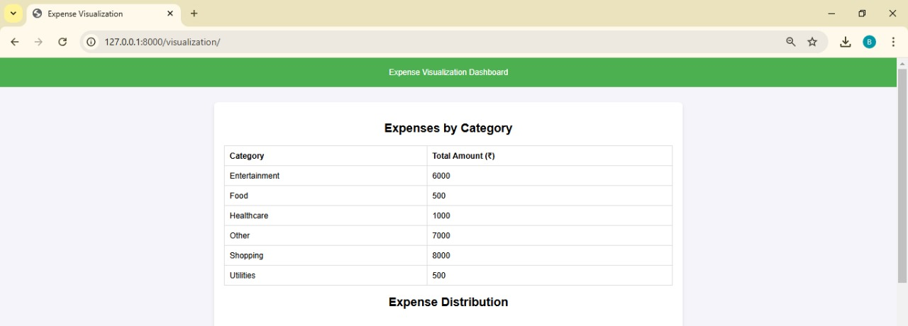
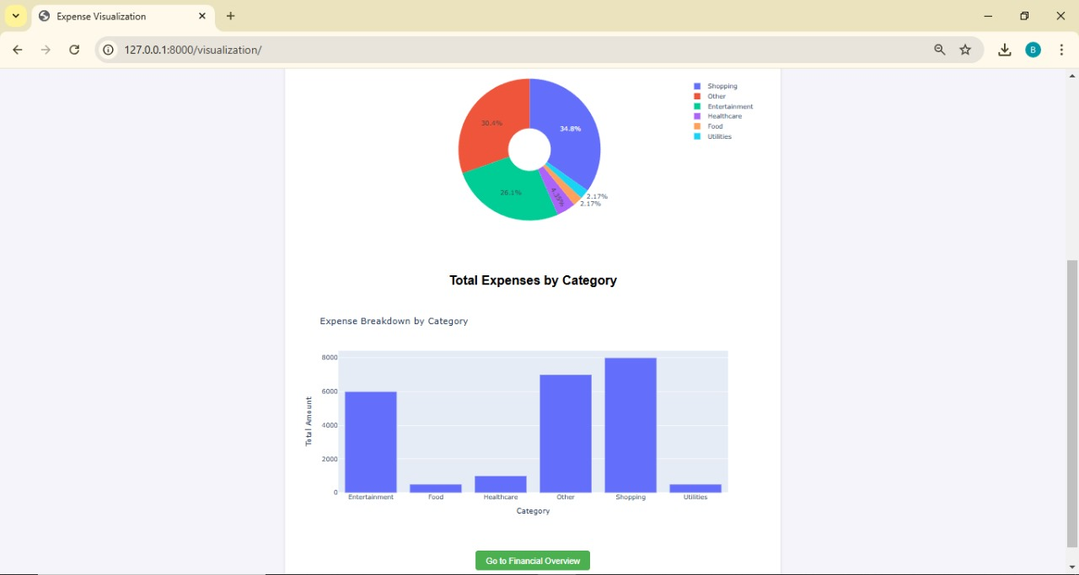
Screenshots
Visualization
Interactive bar and pie charts to represent spending trends over time.

Slide 14

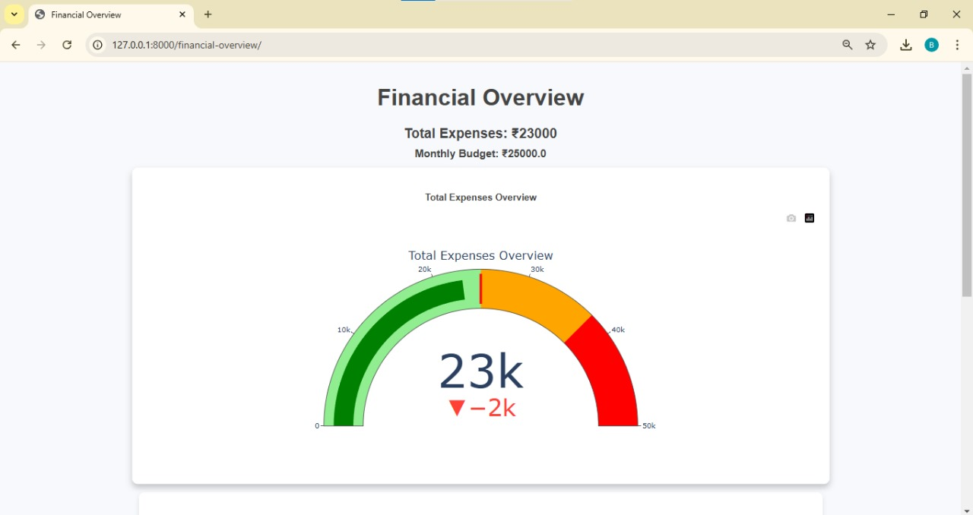
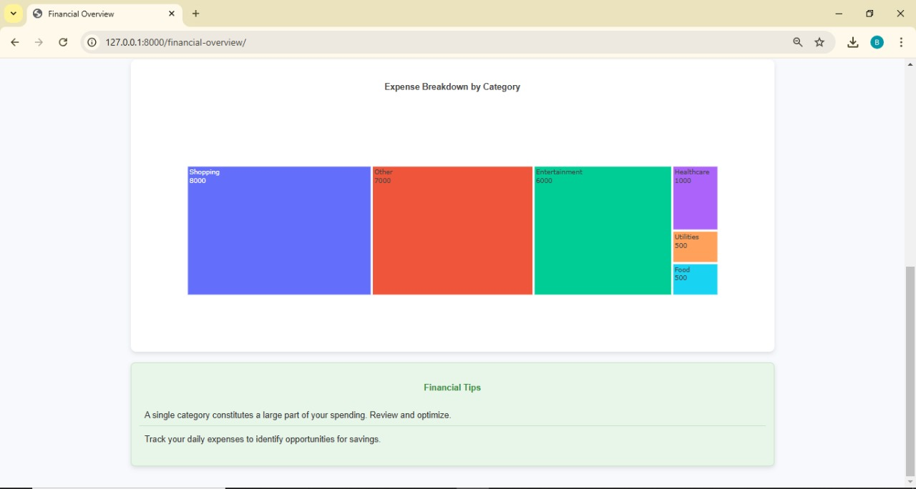
Screenshots
Financial Overview
A comprehensive overview of financial health with metrics, summaries, and trends

Slide 15
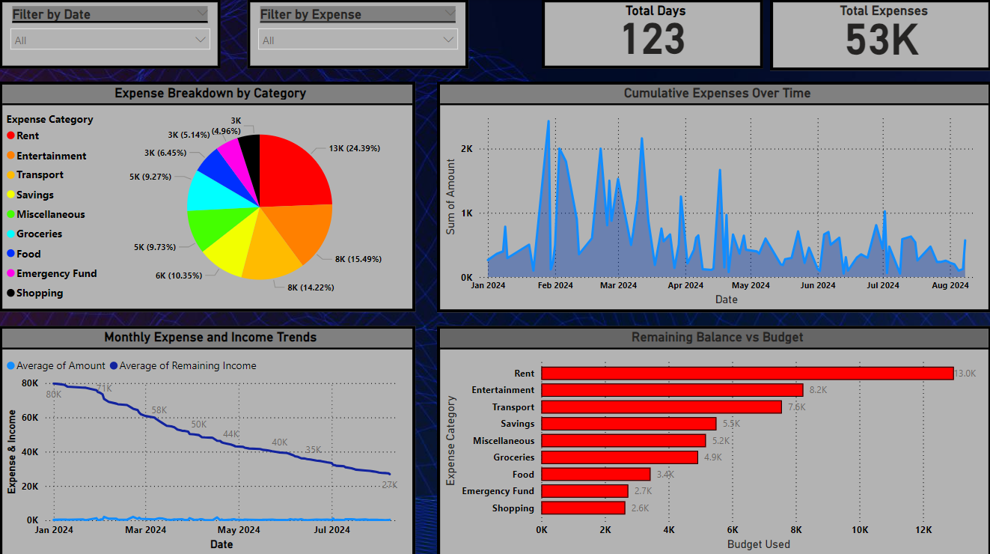
Power BI Dashboard
User data was extracted, converted into an Excel file, and visualized in Power BI. This dashboard provides dynamic insights through intuitive, interactive visualizations.

Slide 16


Conclusion
Successfully developed a Personal Finance Tracker with the following key features:
Expense Tracking and Management: Easy-to-use interface for adding, updating, and viewing expenses.
Financial Reporting with Visual Insights: Interactive graphs and charts to analyse spending habits.
Budget Planning and Alerts: Real-time alerts for overspending and tracking budgets effectively.

Slide 17

Future Scope
AI Integration: Add AI capabilities for personalized financial advice and recommendations.
Multi-User Support: Enable shared budgets for families, teams, or small organizations.
Mobile App Integration: Develop a mobile application for better accessibility and convenience.
Investment Tracking: Expand the system to track investments and savings goals.

Slide 18
THANK YOU

